Slide 1
Modernize Your IT Infrastructure with Ed-Fi: Tech Dive
September 16, 2021

Slide 2
Let’s Get Started!

Slide 3
SEA Modernization Starter Kit – Use Cases
Every kid who is enrolled in a school district at least half time will be counted at the school, rolled up to a district and to the state level as of Oct 1st.
Membership
Number of students, ages 5-21 as of Oct 1st, who are receiving special education services
Special Education Student Count

Slide 4
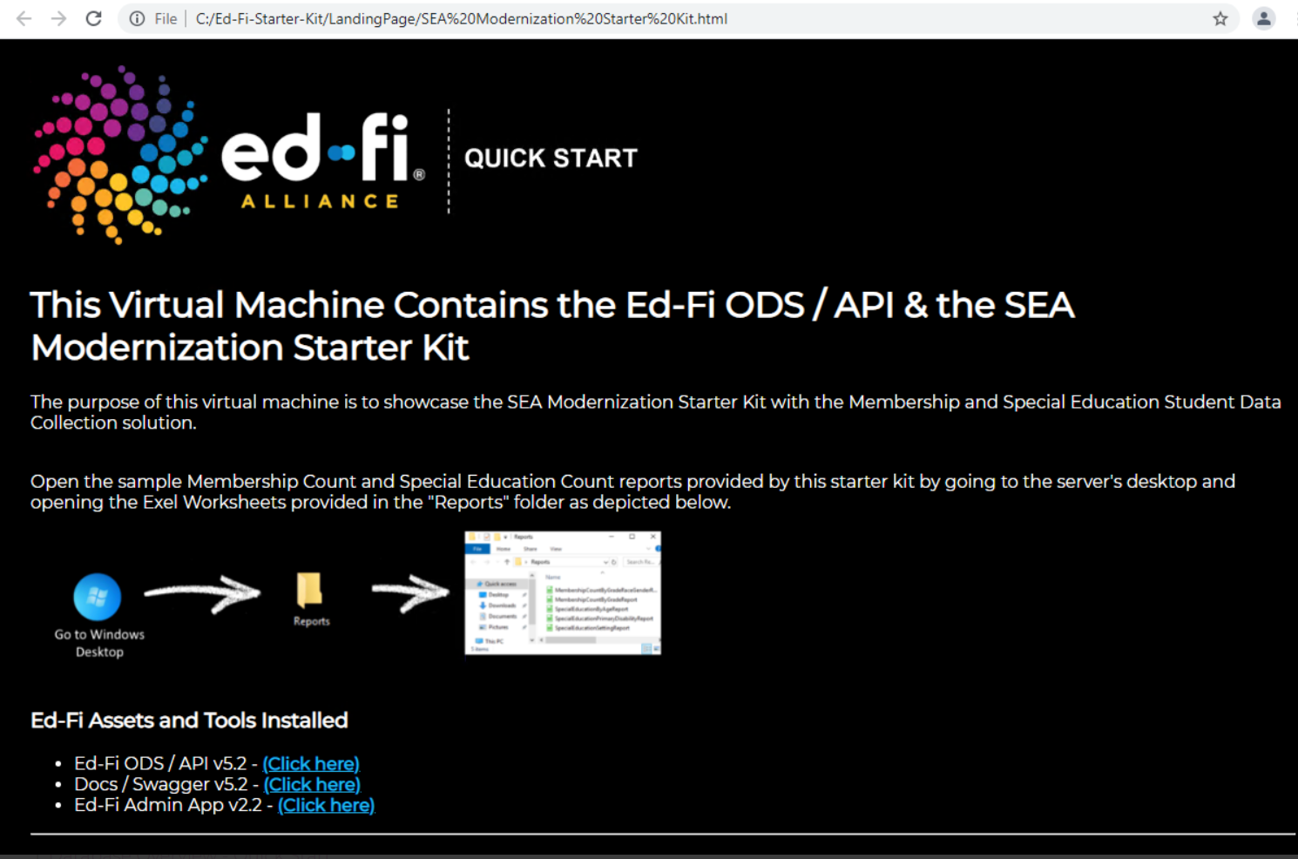
SEA Modernization Starter Kit – Quick Start
Provides a functional virtual environment on AWS.
Allows you to quickly stand up an Ed-Fi environment with the sample data.
Enables you to understand the Ed-Fi technology.

Slide 5
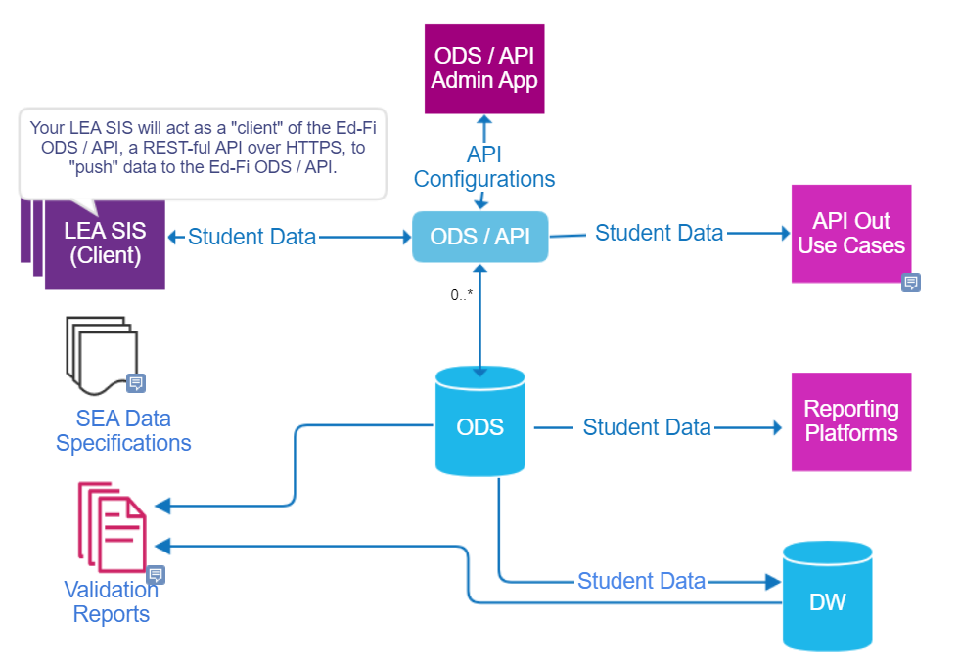
SEA Modernization Starter Kit – Setup Guide
Provides a Pilot-ready environment which you can begin to load Student Information System Data into your Ed-Fi Operational Data Store.

Slide 6
Successful State Architectures
Ed-Fi State Architecture
Successful state architectures look similar in terms of technical processes, but they also share communications and governance processes often not obvious at first glance.
Answers question: is the data flowing and what exactly did we submit?
Answers question: is our data submission valid and what do we need to fix? Integrity reports should connect data to consequences of that data (AZ)
LEA
SEA Data Specifications
LEA Data Steward(s)
Data Visualizations (Early Warning Systems, Dashboards, etc.)
SEA data specifications are a key input and published 6-8 months in advance of production.
LEA SIS
SIS Error Reports
Submission Report
Integrity rules
Integrity report
HTTP
SEA
REST API
Datamarts for reporting (de-normalized)
Ed-Fi ODS
Multi-year ODS
State SLDS
Identity System
Validations Engine
Audit useful in both internal and external processes
Audit trail
Audit trail
Error reports
Publication of integrity rules to LEAs helps complete the circle of expectations.
Introduces multi-year schema (as integrity rules cross years).
May be multi-year, derivative format of Ed-Fi ODS DB schema or a separate system.
LEAs lose sight of data here.

Slide 7
Upcoming Events
SEA Bootcamp – Oct 14, 2021

Slide 8
The Ed-Fi Alliance is here to ensure that your state can make student data more accurate, secure, and useable.
Maureen Wentworth, Manager, Strategic Partnerships maureen.wentworth@ed-fi.org
512-600-3620
Sayee Srinivasan, Solutions Architect
Sayee.srinivasan@ed-fi.org
512-600-3618

