Slide 1
Streamlining Immunization Health Record for Districts
Wisconsin DPI + Ed-Fi

Slide 2
Welcome!
Welcome!
20-minute presentation, 10 minutes of Q&A
Use the Webex Q&A feature to submit a question at anytime
What We’ll Cover
Problem and Solution
Workflow
Onboarding districts/vendors
Feedback from districts/vendors
Notes:
Who will this help?
How do I get started?
More on the Ed-Fi tools and analytics middle-tier
Getting vendors connected
Where to find us

Slide 3




Hello!
Jaidaa Shafaei
Product Owner/Scrum Master
WISEdata Collections
3.7 years @ WI DPI
10+ in Project Management &
Business Analysis
Contact: jaidaa.shafaei@dpi.wi.gov
Caroline Kazmierski
Communications &
Marketing Director
6.0 years @ Ed-Fi
Tech PR expert
Contact:
Caroline.Kazmierski@ed-fi.org
Tom Christensen
Developer
WISEdata Collections
10 years @ WI DPI
15+ years in technology
Contact: thomas.christensen@dpi.wi.gov
Sayee Srinivasan
Community Partnership Manager,
SEA
5.5 years@ Ed-Fi
13 years in education technology
Contact: Sayee.Srinivasan@ed-fi.org

Slide 4
Problem
To meet state and local vaccine mandates, schools invest significant manpower and time to update and verify immunization records

Slide 5
Solution
An API integration solution using Ed-Fi to retrieve student immunization records from the Wisconsin Department of Health Services (DHS) and pass it back to the LEA’s through the student information system.

Slide 6


Workflow
LEA
DHS
SIS
DPI
DHS
SIS
  Opts in via WISEadmin, configures SIS, and fills out DHS forms
  Sets up school account in WIR, and updates the ed-fi credential app.
  Sends a GET request to WISEdata API using the student WISEid
  Passes basic student info for matching
  Returns payload to SIS vendors
  DHS validates patient demographics through a matching algorithm, and returns a result
  Displays vaccine records for the returned match
ISS- HL7
WISEdata API - JSON
One directional Integration between WIR and WISEdata Ed-Fi API
Notes:
LEA: logs to WISEadmin Portal and opts into the immunization data sharing, and works with DHS to set up a WIR account for each school in their district (process improvement for DHS: they had a district-level account; now changing to school-level)
DHS: Sets up the school in WIR, updates the school information in the Ed-Fi Credential application HL7 (process improvement for DHS: DHS has different name and ID for schools than what DPI has.)
SIS/LEA: Queries for immunization records occur by providing a WISEid for a single student (DHS server constraint).
DPI: Needs a student enrollment record for authorization (constraint for schools that don’t not report student enrollments to WDP, e.g. tribal schools and private schools)
DPI sends the student first name, middle name, last name, gender, address ‘if provided’
DHS: Validates patient demographic and retunes a result
DPI: Once the query is complete, immunization history information populates in JSON (HL7 > JSON).
SIS: imports the data into their product and flags any potential duplicates for manual review.
This is a one-directional integration, meaning LEAs cannot enter immunization records into WIR through their SIS.

Slide 7
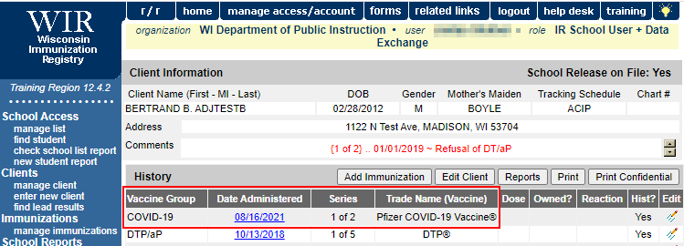
API Response
{ "statusCode": 1,
"statusMessage": "Success",
"data": {
"patientIdentifier": {
"id": “xxxx",
"assigningAuthority": "WIA",
"identifierTypeCode": "SR",
"name": {
"firstName": "BERTRAND",
"middleName": "B",
"lastSurname": "ADJTESTB", },
"mothersMaidenName": {
"firstName": "BETTY",
"lastSurname": "BOYLE" },
"birthDate": "2012-02-28T00:00:00Z",
"sex": "M",
"race": "^Unknown/undetermined^CDCREC",
"address": {
"street": "1122 N Test Ave",
"other": "", "city": "MADISON",
"state": "WI", "zip": "53704", },
"studentReference": {
"studentUniqueId": "2488013423",
"link": {
"rel": "Student",
"href": "/ed-fi/students/2a5324c7673b4f21bc021d72561a716c“ } },
"studentEducationOrganizationAssociationReference": {
"educationOrganizationId": 7273,
"studentUniqueId": "2488013423",
"link": {
"rel": "StudentEducationOrganizationAssociation",
"href": "/ed-fi/studentEducationOrganizationAssociations/d0ea8cc735214cc0abbf92ff529a18aa“}},
"pharmacyTreatmentAdministrations": [{
"administeredDate": "2021-08-16",
"administeredCode": {
"identifier": "208",
"text": "Pfizer COVID-19 Vaccine",
"nameOfCodingSystem": "CVX",
"alternateIdentifier": "Pfizer COVID-19 Vaccine",
"alternateText": "Pfizer COVID-19 Vaccine",
"alternateNameOfCodingSystem": "WVTN" }

Slide 8
LEA WIR Setup
A page in the Ed-Fi Credential Application to help DHS maintain the schools’ setup and know whether an LEAs has opted into the immunization integration or not.

Slide 9
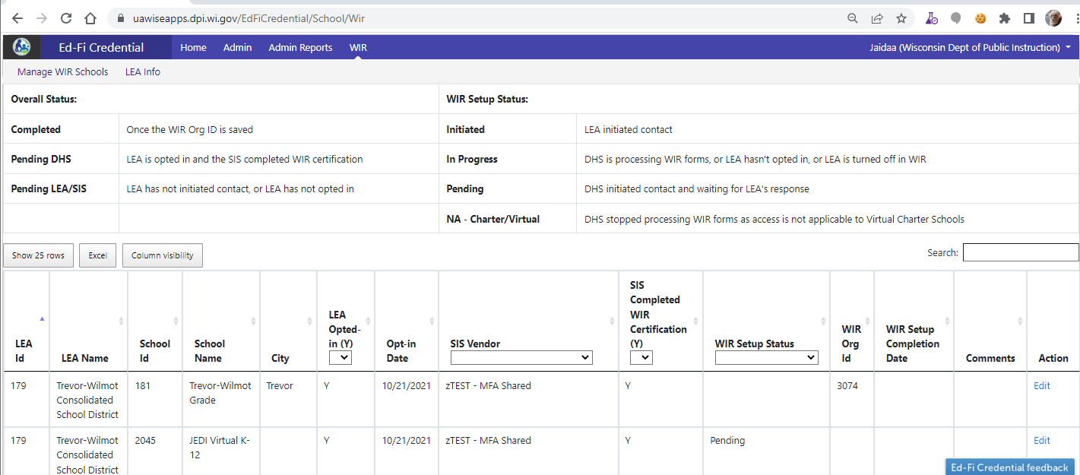

Slide 10



Outcomes
Accurate student immunization records to meet school entry immunization requirements is easily retrieved.
Interoperability between the SIS and the immunization information systems (IIS).
Positive outcomes for the schools are realized, such as:
  Cost savings in terms of staff time
  Better management of vaccination records, including COVID-19 vaccines.

Slide 11
Feedback
“This has been a huge issue for schools for as long as I have been involved in education (over 20 years now). The hours this will save school staff every year is unfathomable. My nurses are ecstatic about this and can't wait to use it.
Again, thank you so much for this. This is a gamechanger for all Wisconsin school districts who choose to use this feature.”
-- Shawano School District
Good news first - WE WERE ABLE TO DO THE WIR UTILITY finally this AM (fixed the issue) so just imported 1 school's immunizations in about an hour! Something that used to take me about 30 hours.”
-- Plymouth School District
“Appreciate everyone’s hard work on this much needed project!!”
-- Necedah Area School District
“This is a wonderful addition and we are excited to see how this feature will work. We're hoping to start using it now so we have it all figured out before a class of new students enrolls in the fall! This will be a great timesaver for our staff!”
-- Stanley-Boyd School District
“This is such a great option to have added to our SIS via DPI. Thank you for implementing and helping configure the process.”
-- Wheatland J1 School District

Slide 12
Resources
Information for LEAs
Tech Specs for Vendors
Programmer's Guide for Immunization Registry Integration
Source code on Ed-Fi Exchange

Slide 13
Thank you!

